Slide 1
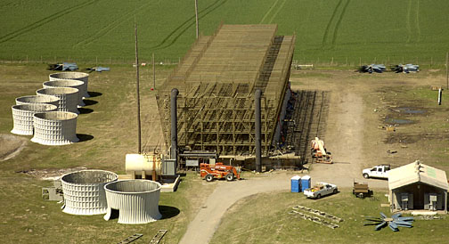
Midwest
COOLING TOWERS, INC
Reconstruction, Upgrade
and Repair

Slide 2
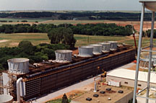
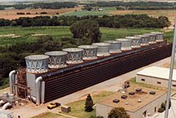
Reconstruction & Upgrade

Slide 3
Reconstruction & Upgrade
Safety is the highest priority and we have an outstanding record
Our experienced engineering and design group can provide solutions for all your cooling tower design challenges.
An extensive manufacturing facility with over 500,000 board feet of cooling tower lumber
Our full-time construction staff can design, manufacture, and install your project.

Slide 4
Reconstruction & Upgrade
Structural lumber replacement or repair
Structural lumber replacement with custom fiberglass structural shapes
Mechanical equipment repair or upgrade
Fill system replacement
Drift eliminator system replacement
Fan deck repair / replacement
Hot water basin repair / replacement
Hot water basin covers

Slide 5
Reconstruction & Upgrade
Crossflow distribution systems
Counterflow distribution systems
Casing and louver replacement
Experienced with all makes and models of cooling towers
Thermal performance upgrades
Complete cooling tower refurbishments

Slide 6
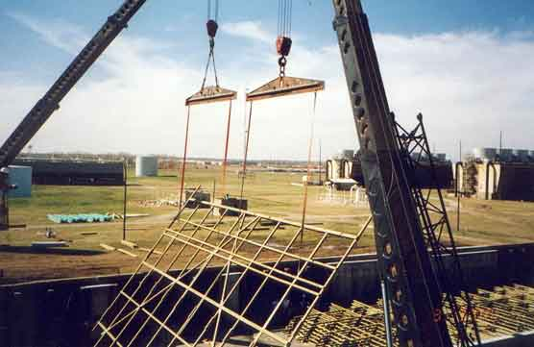
Reconstruction Sequence

Slide 7
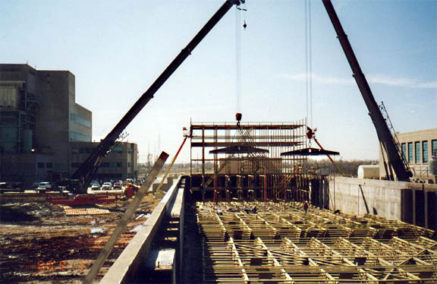
Reconstruction Sequence

Slide 8
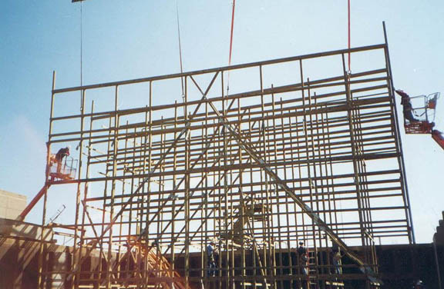
Reconstruction Sequence

Slide 9
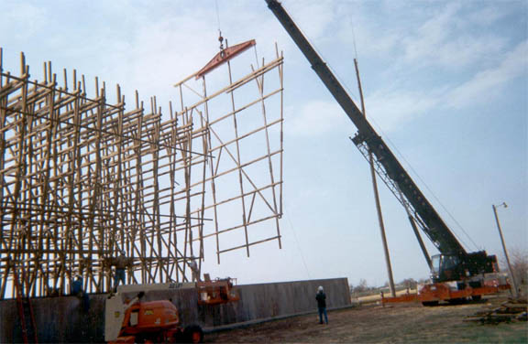
Reconstruction Sequence

Slide 10
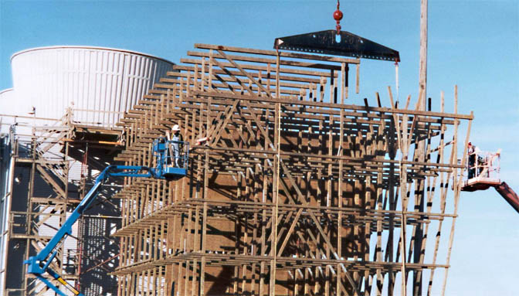
Reconstruction Sequence

Slide 11
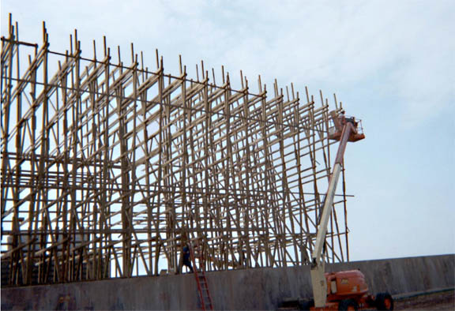
Reconstruction Sequence

Slide 12
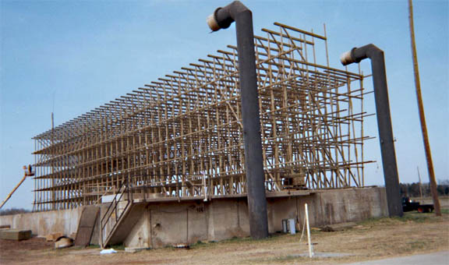
Reconstruction Sequence

Slide 13
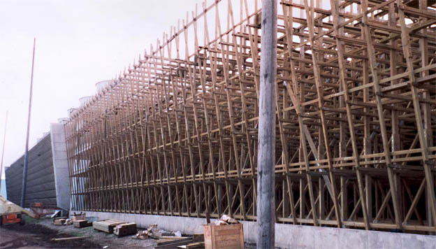
Reconstruction Sequence

Slide 14
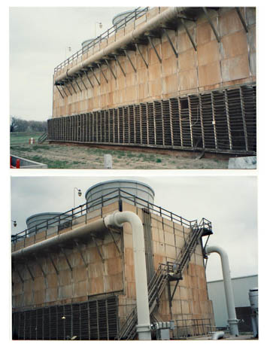
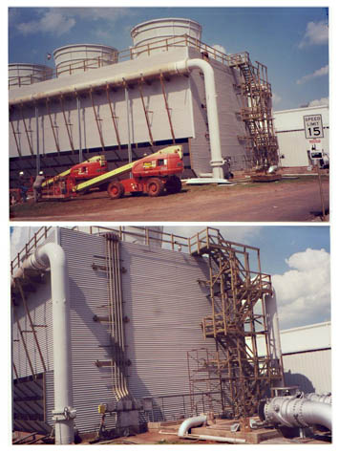
Typical Results
Before
After

Slide 15
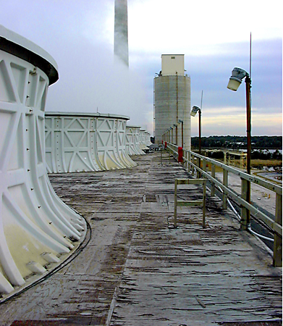
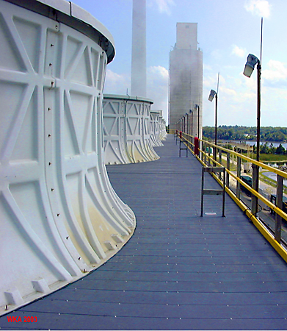
Typical Results
Before
After

Slide 16
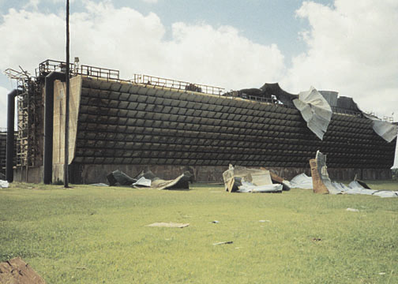
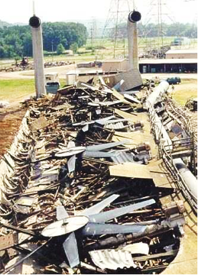
Repair & Emergency Services
Getting you up and running is the most important thing.

Slide 17
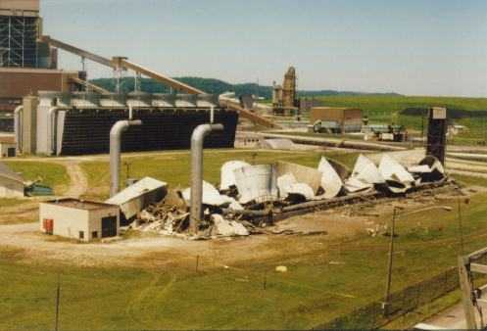
Repair & Emergency Services
Fast, effective response.

Slide 18
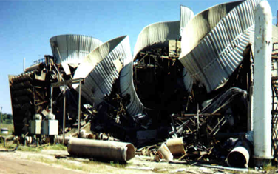
Repair & Emergency Services
24/7 availability

Slide 19
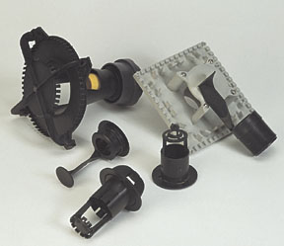
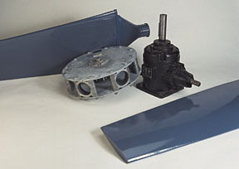
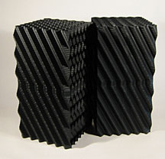
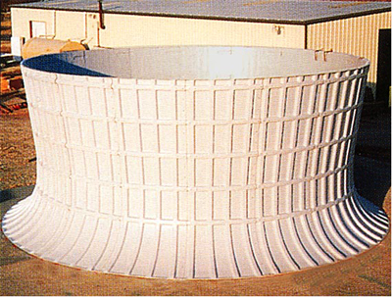
Parts & Components

Slide 20
Parts & Components
High quality, reliable, low-cost alternative to expensive original equip. parts
Large selection
Compatible with virtually all models and manufacturers
Our large buying power results in cost savings passed directly to you

Slide 21
Parts & Components
Custom lumber fabrication and treating
Fiberglass fan stacks and distribution systems
Custom fiberglass wood replacement structural shapes
Non-skid fiberglass fan deck and hot water basins

Slide 22
Parts & Components
Corrugated FRP casing and louvers
Fans and assemblies, gears, speed reducers, drive shafts, couplings, motors, supports
Flow control valves, nozzles, grommets
Fill and drift eliminators
Hardware, brace connectors, base anchors

Slide 23
Midwest
COOLING TOWERS, INC
Corporate Office: Chickasha, OK Tel 405.224.4622 Fax 405.224.4625
www.mwcooling.com sales@mwcooling.com

