Slide 1
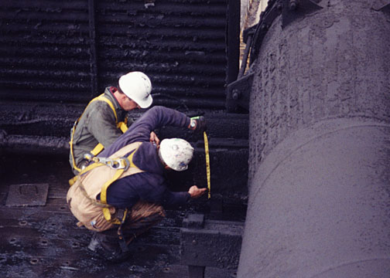
Cooling Tower
Maintenance Training

Slide 2
Training Overview
Safety First
What is a Cooling Tower
Cooling Towers
Components
Structure
Inspection / Maintenance Summary
Questions / Discussion

Slide 3
Safety First
Identify potential hazards
Plan ahead
Follow safety and health regulations
Use personal protective equipment

Slide 4
What Is a Cooling Tower?
A cooling tower is a piece of equipment that derives a primary cooling effect from the evaporation of water when brought into direct contact with air. Cooling towers are designed to expose the maximum transient water surface to the maximum air flow.

Slide 5
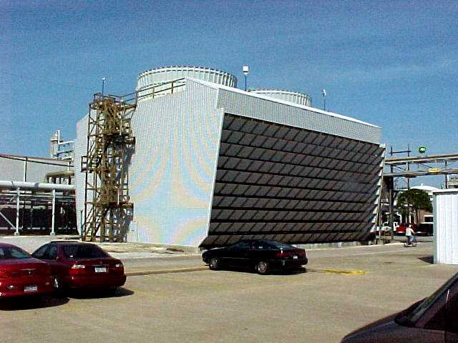
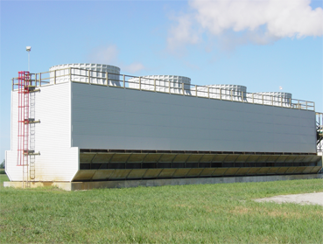
Types of Cooling Towers
Crossflow towers
Counterflow towers

Slide 6
Crossflow Cooling Towers
Crossflow cooling towers use splash fill media through which the incoming cool air flows horizontally ACROSS the downward flow of hot water from the top distribution basins. These types of towers were predominantly used from the 1950’s through the 1970’s.

Slide 7
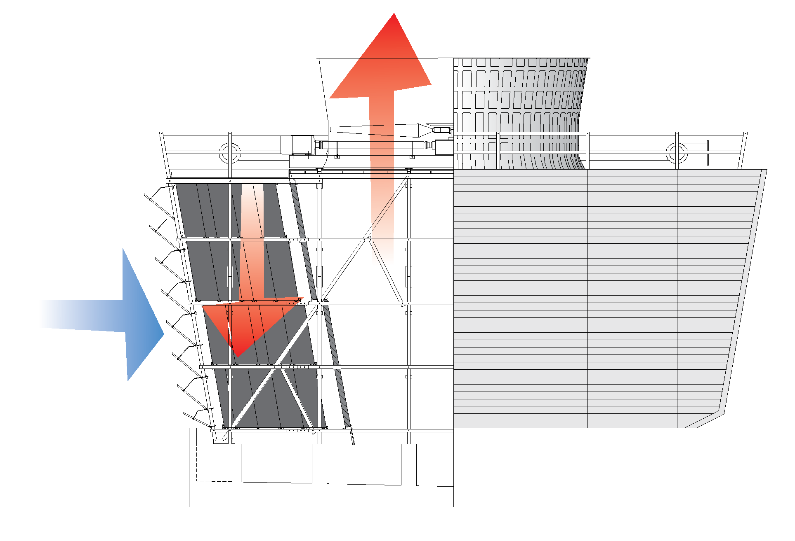
Crossflow Cooling Tower

Slide 8
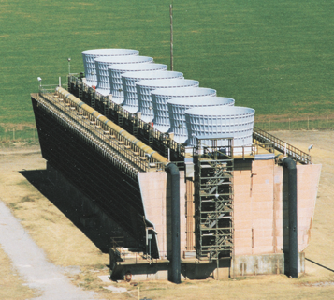
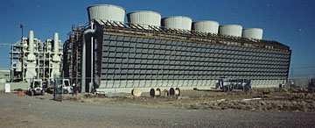
Typical Crossflow Towers

Slide 9
Counterflow Cooling Towers
In counterflow cooling towers the incoming cool air moves vertically up through the fill media, COUNTER to the downward flow of hot water coming from the distribution laterals. These types of towers are commonly used in today’s applications.

Slide 10
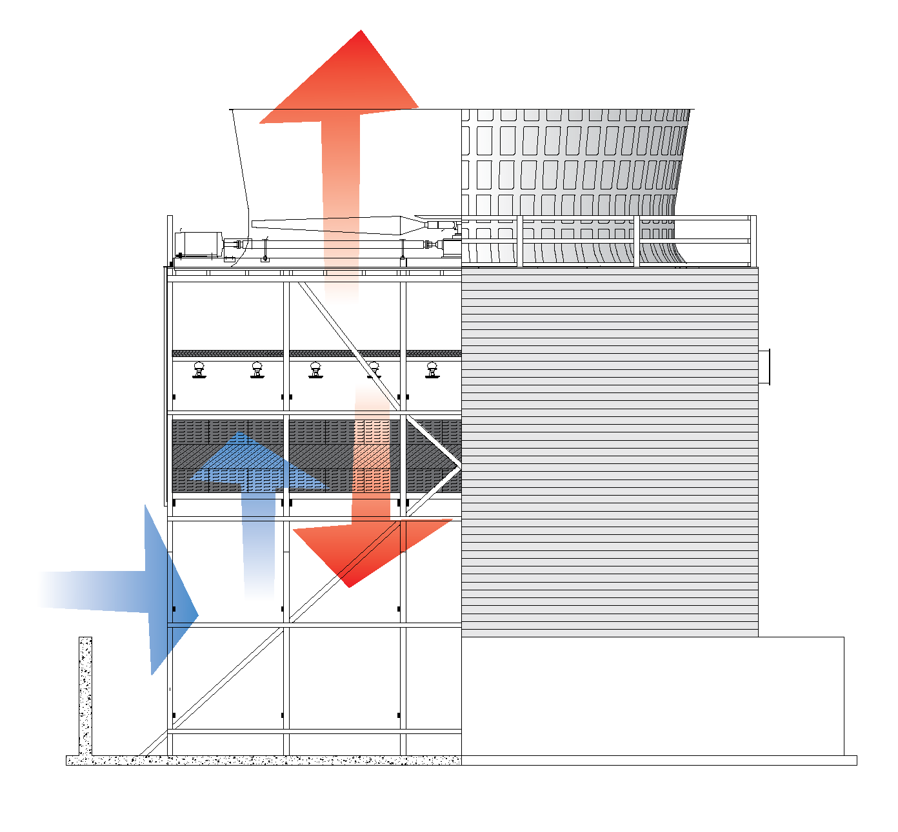
Counterflow Cooling Tower

Slide 11
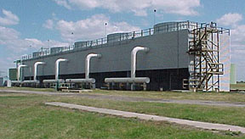
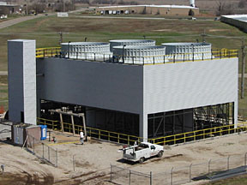
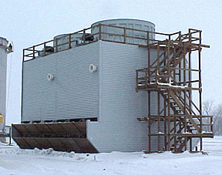
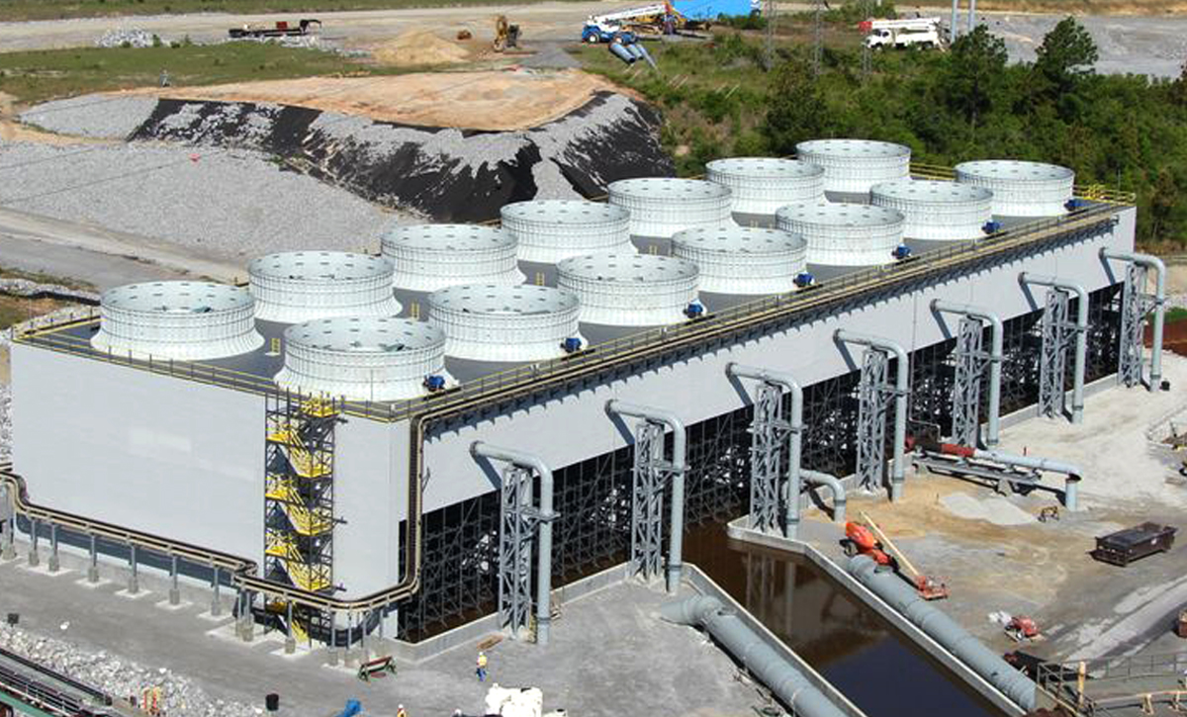
Typical Counterflow Towers

Slide 12
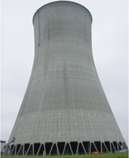
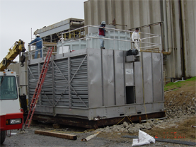
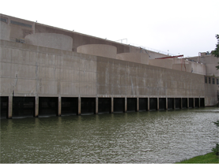
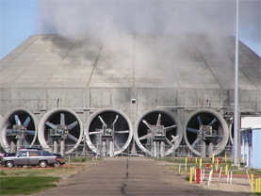
Other Types of Cooling Towers

Slide 13
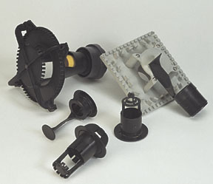
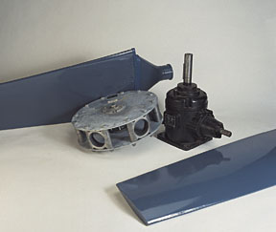
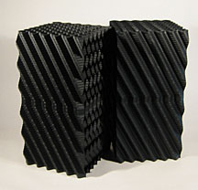
Cooling Tower Components

Slide 14
Cooling Tower Components
Counterflow

Slide 15
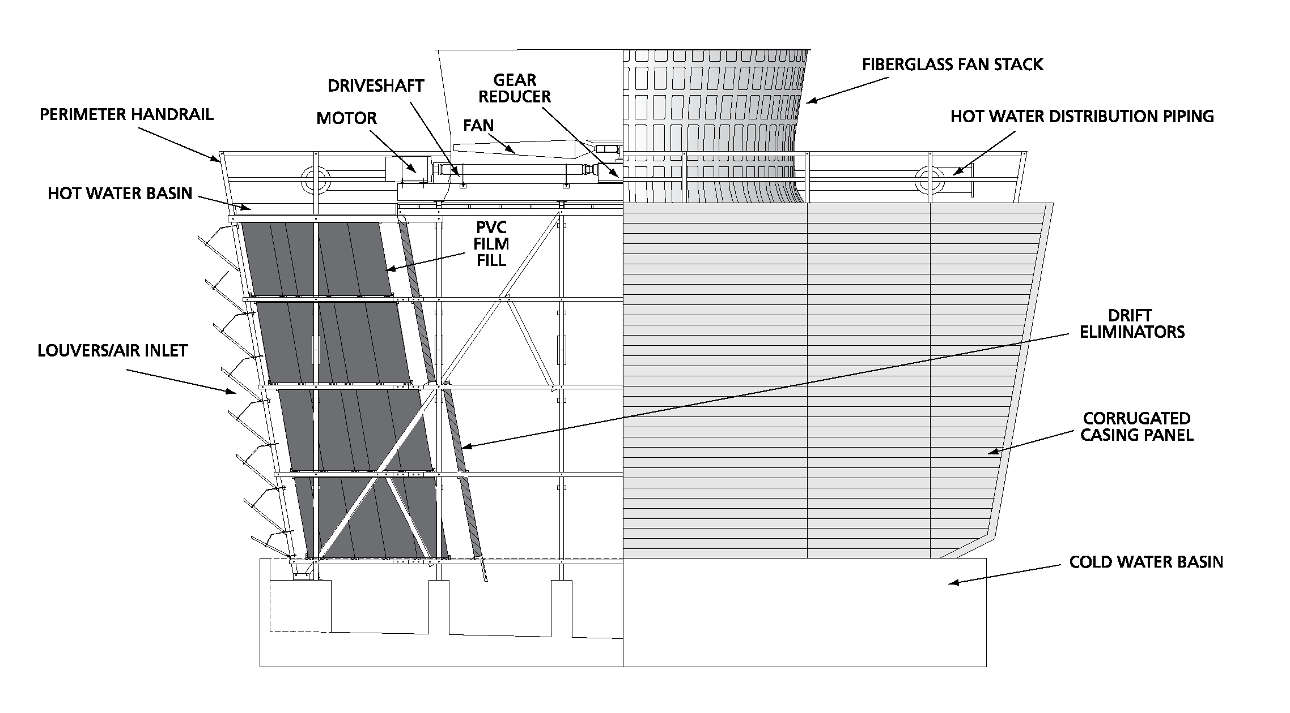
Cooling Tower Components
Crossflow

Slide 16
Fan Stacks
Check for cracks
Check & tighten any loose hardware
Check & clean weep holes

Slide 17
Air Inlet Louvers
Reduce splash out & water loss
Check for broken arms or rods after winter operation

Slide 18
Distribution System
Maintenance interval: Annually
Check lateral to header joints for bushing leakage

Slide 19
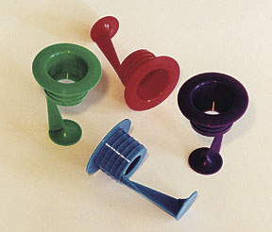
Distribution Nozzles
Maintenance interval: Annual full inspection
Monthly ground level visuals
Uneven flow
Plugged nozzles
Repair: clean out

Slide 20
Fill Media
Maintenance interval: Annual
Inspect for plugging or biological fouling
Check for damage to top surface
Check bottom of fill for sagging caused by exceeding temperature limitation

Slide 21
Plugged Film Fill

Slide 22
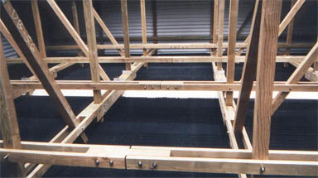
Drift Eliminators
Maintenance interval: annual inspection
Look for damaged or plugged sections
Look for gaps that permit water bypass
Repair: replace damaged sections

Slide 23
Mechanical System

Slide 24
Motors
Maintenance interval: semi-annual
Grease inboard & outboard bearings
Motor may have zerk and grease relief vent, or may have plugs

Slide 25
Motors
Keep drive shaft installed during operation

Slide 26
Motor Lubricant
Use a poly urea base grease with a good grade of petroleum oil, No. 2 consistency
If grease vent plug is NOT removed, grease enter motor windings, causing premature motor failure

Slide 27
Drive Shaft & Coupling
Maintenance interval: Annual or after high torque event
Check alignment
Inspect for corrosion, soft spots or cuts in shaft
Check flex coupling for protrusions or bumps on surface

Slide 28
Gear Boxes
Maintenance interval: change oil after first 500 hours or 4 weeks, then every 2,500 hours or 6 months
During shutdown periods: cool down gear box for 4 hours, then run 5 minutes/week until startup
Check oil weekly

Slide 29
Gear Box Tips
Two-speed motors: switching from High Speed to Low Speed requires coast-down to below Low Speed rpm before activating motor at Low Speed
Can be done manually
Recommend timer in circuit to permit fan to coast for specified time before Low Speed is activated

Slide 30
Gear Box Tips
Variable speed drive operation: Do not operate a standard gear box below 450 rpm due to lubrication problems
Inspect case for excessive deposits which may cause overheating

Slide 31
Gear Box Tips
Extended Shutdown
Fill gear box case with oil to top of case through oil breather port and cover with tarp
Before restart: Don’t forget to return oil to correct level prior to operation

Slide 32
Gear Box Vent Lines
Maintenance interval: weekly checks
Look for blockage in line
Repair: clean out
Blockage causes pressure build up in case

Slide 33
Fan Assembly
Maintenance interval: by opportunity
Check fan tip clearance
Visually check leading edges for wear
Inspect surface for scale build-up
Check hub end of blades for cracks
Clean weep holes

Slide 34
Fan Hub
Maintenance interval: annual
Inspect connections between hub and blades
Check for loose connection between hub and cover

Slide 35
Vibration Switches
Maintenance interval: As required for trip delay set point
Brochures available from Midwest Towers

Slide 36
Cooling Tower Structure

Slide 37
What Can Go Wrong?

Slide 38
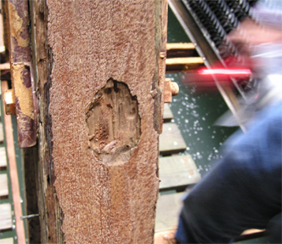
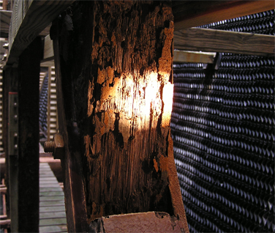
Deteriorated Structure

Slide 39
Over Tightened Hardware

Slide 40
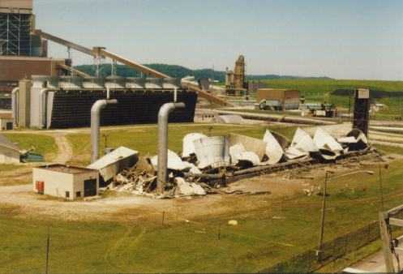
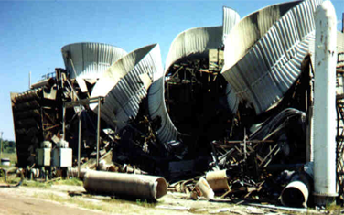
Structural Failure

Slide 41
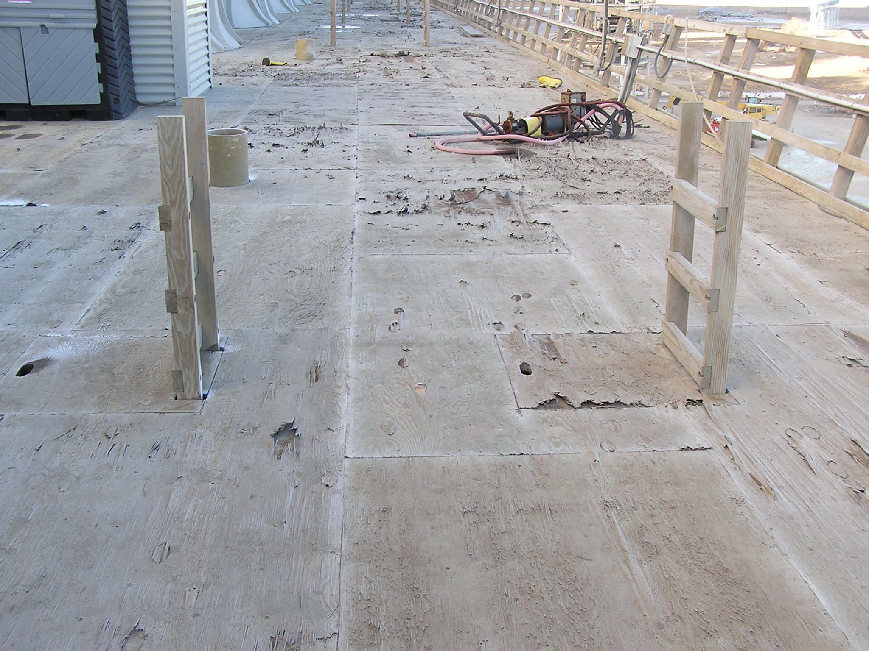
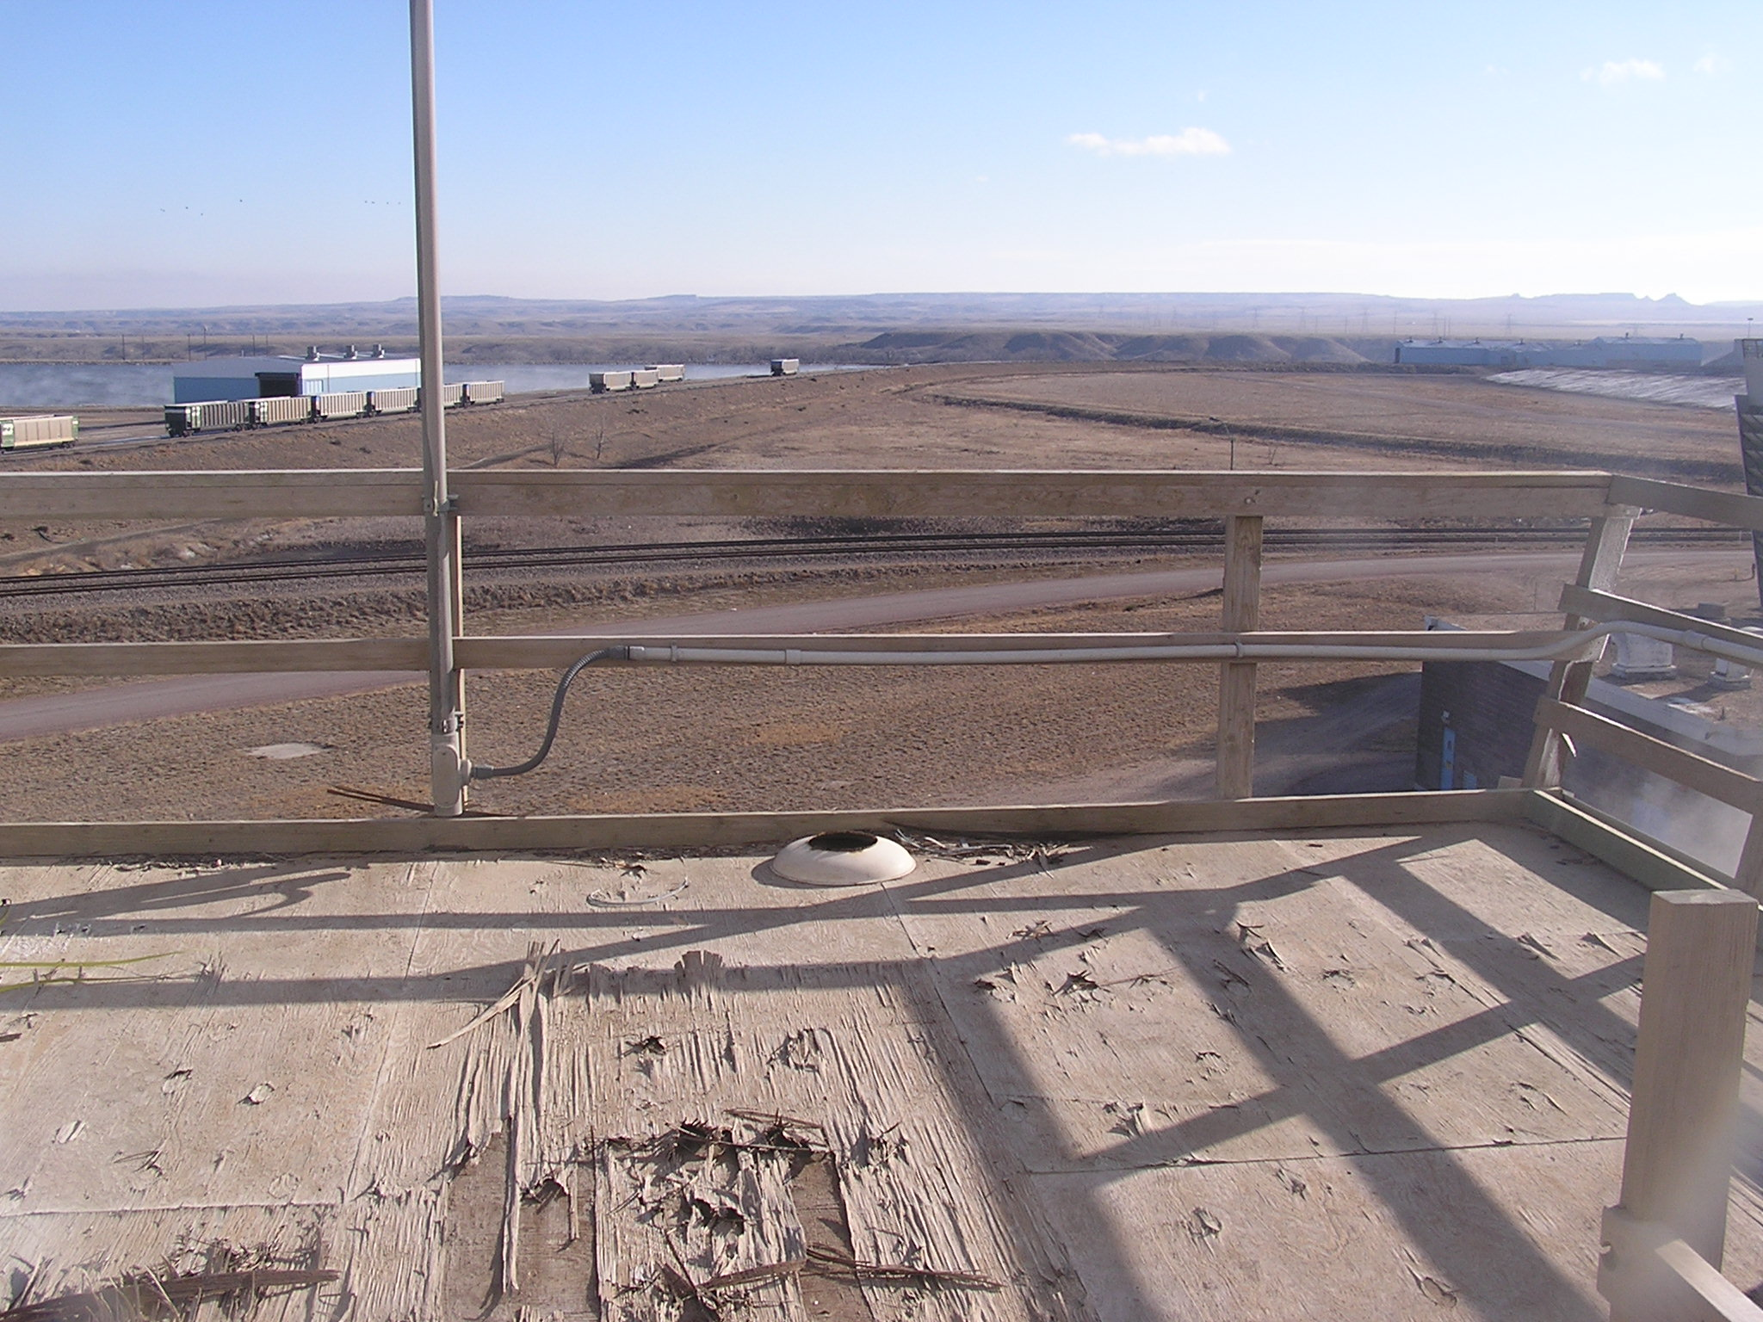
Delaminated Fan Deck

Slide 42
Structural Inspection Tips
Check for signs of biological or chemical attack annually
Check for cracks or deterioration annually
Check & tighten any loose hardware annually
Replace any damaged structure immediately

Slide 43
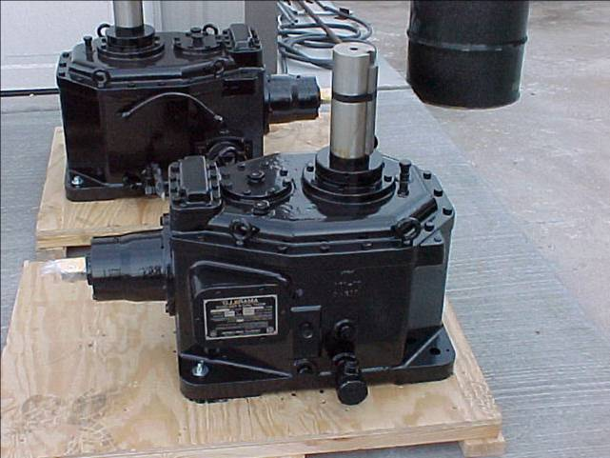
Recommended Spare Parts
(1) Gearbox
(1) Drive Shaft
(10) Nozzles
(10) Louver Arms (If applicable)

Slide 44
Inspection/Maintenance Summary
Weekly
Check gear box oil level & drive vent tube
Monthly
Check nozzles for uneven flow or plugging
Semi-Annually
Replace motor bearing grease

Slide 45
Inspection/Maintenance Summary
Annually
Inspect structure for cracks & deterioration
Check, clean & if necessary replace distribution nozzles
Check & clean fan blades & weep holes
Check fill for damage, plugging or biological growth

Slide 46
Inspection/Maintenance Summary
Annually
Check drift eliminators for damaged sections or gaps
Inspect fan stacks for loose hardware
Check drive shaft & coupling (also after high torque event)
Check fan blades for wear, cracks, scale & tip clearance (also at any opportunity)

Slide 47
Inspection/Maintenance Summary
Change gear box lubricant after first 500 hours or 4 weeks, then every 2,500 hours or 6 months of continuous operation

Slide 48
Questions
If you are unsure about what to check or have any questions or concerns, please feel free to contact your Midwest Towers representative to schedule a cooling tower inspection.

Slide 49
Midwest
COOLING TOWERS, INC
Corporate Office: Chickasha, OK Tel 405.224.4622 Fax 405.224.4625
www.mwcooling.com sales@mwcooling.com

